Slide 1
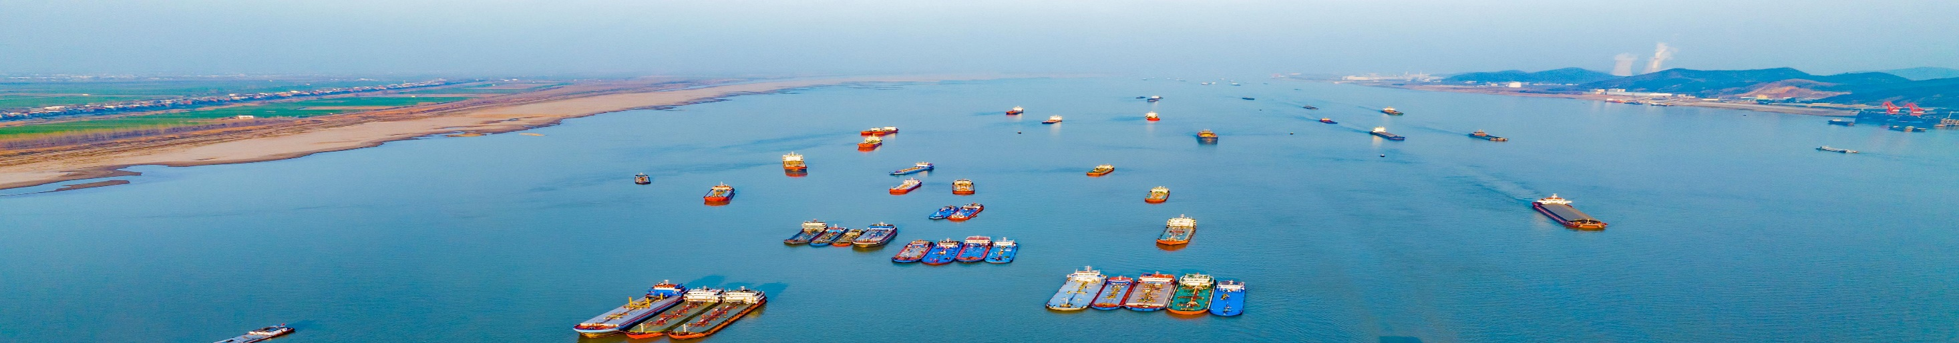
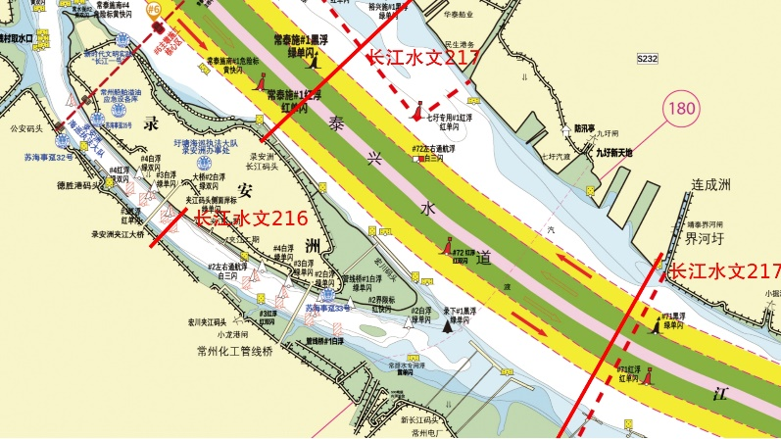

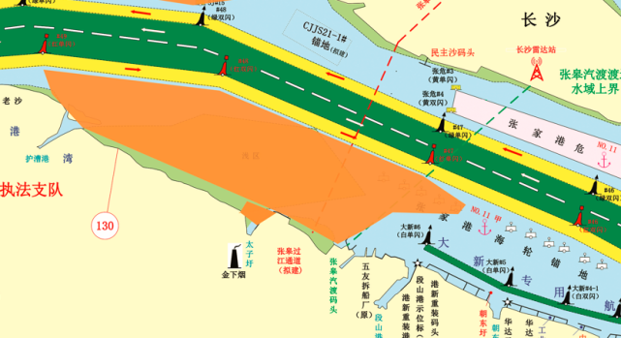
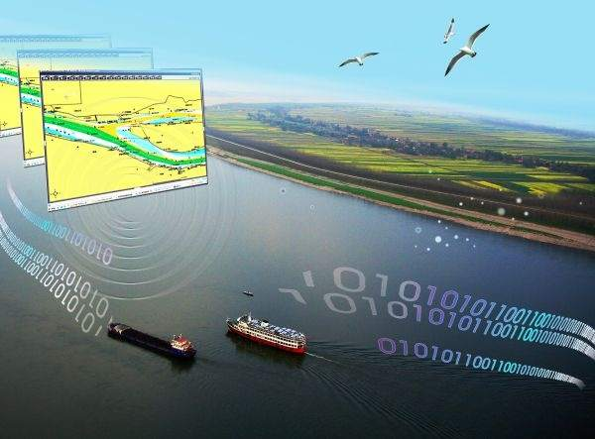
China IENC Development Status
Liu Li
China Waterborne Transportation Institute

Slide 2

Contents
High-grade Inland Waterway Plan
IENC development mileage
IENC standards
National Inland Waterway Map
Notes:
twenty-five thousand
by the year twenty and thirty-five

Slide 3
1. China high-grade inland waterway plan
Chinese overall layout of inland waterway transportation is consisted of“four vertical ,four horizontal and two networks” high-grade inland waterways.
The planned waterway mileage is about 25000 kilometers by 2035.
Notes:
twenty-five thousand
by the year twenty and thirty-five

Slide 4
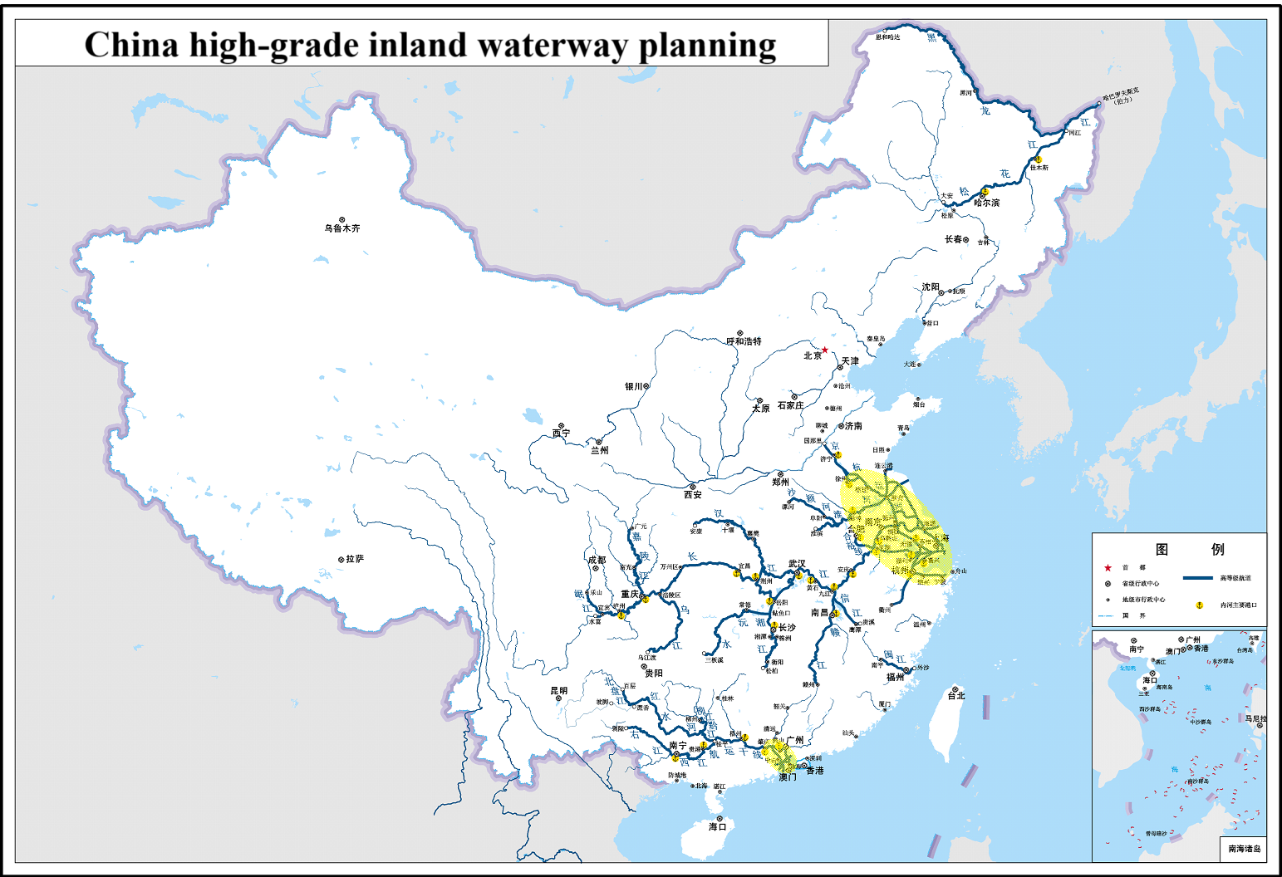
China high-level inland waterway planning
四纵
四横
Two networks waterways
Yangtze River Delta
inland waterway network
Pearl River Delta
inland waterway network
Notes:
5500

Slide 5
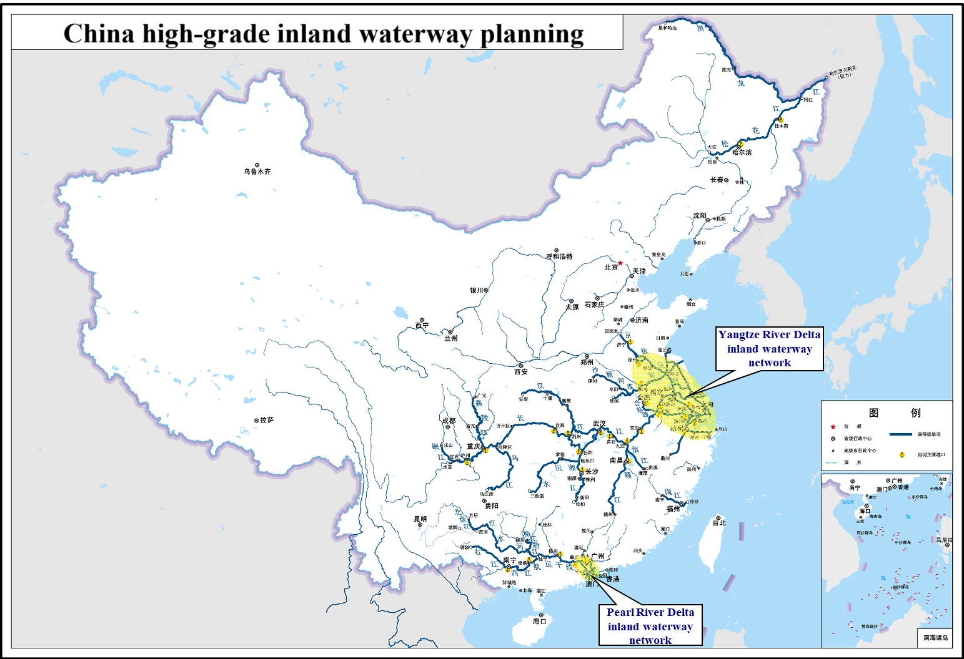




Four horizontal waterways
Yangtze river and its branches，5400
Xijiang river and its branches，3400
Huaihe river and its branches，1000
Heilongjiang river and its branches，2700
Notes:
The first horizontal waterway is Yangtze river and its branches, about 5400 kilometers
The second is Xijiang river and its branches，about 3400 km
The third is Huaihe River and its branches，about 1000 km
The fourth is Heilongjiang River and its branches，about 2700km

Slide 6




Four vertical waterways
Beijing-Hangzhou Grand Canal and Hangyong canal，1200
Shaying river and Jianghuai canal，1300
Zhegan canal, Xinjiang river , Ganjiang river , Ganyue canal，1600
Hanjiang river, Xiangjiang river , Xianggui canal, Pinglu canal，2300
Notes:
The first vertical waterway is consisted of Beijing-Hangzhou Grand Canal and Hangyong Canal, about 1200 kilometers
The second is Shaying River and Jianghuai Canal, about1300 kilometers
The third is consisted of Zhegan Canal, Xinjiang river ，Ganjiang river ,Ganyue Canal and so on, about 1600 kilometers
The fourth is Hanxianggui Channel including Hanjiang river, xiangjiang river ,xianggui canal，and Pinglu canal, about 2300 kilometers

Slide 7
2. China IENC Produce Status
Completed: 15900km，high-grade waterways
Covered most waterway of “four vertical ,four horizontal and two networks” high-grade inland waterways.
Coverage mileage of high-grade waterways across the country by 2024
Notes:
Fifteen thousand and nine hundred kilometers，

Slide 8
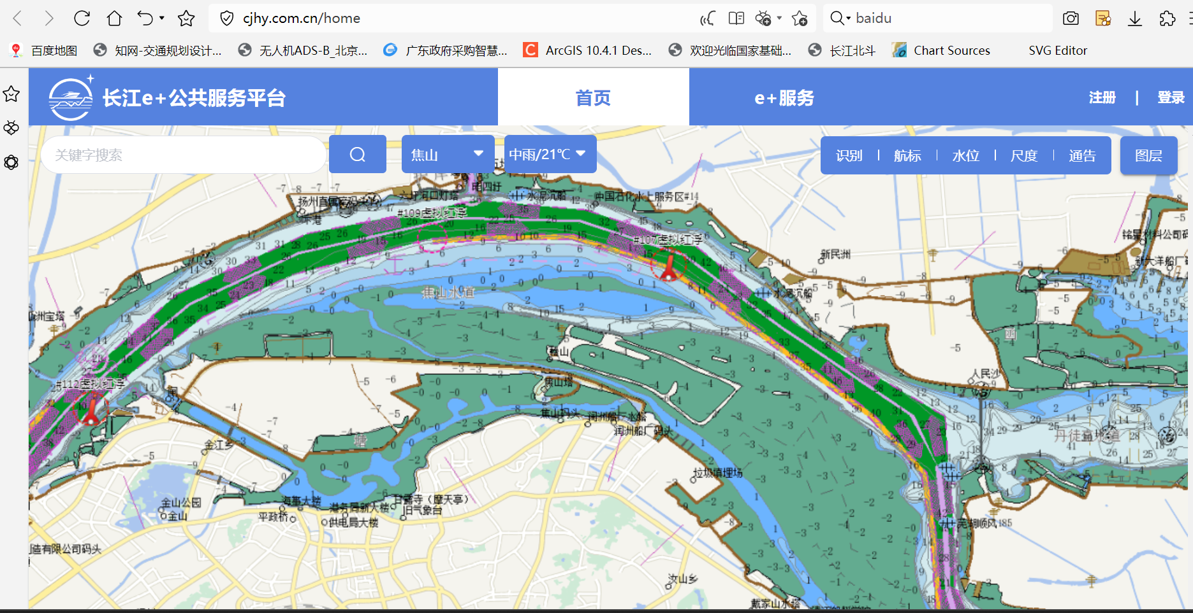
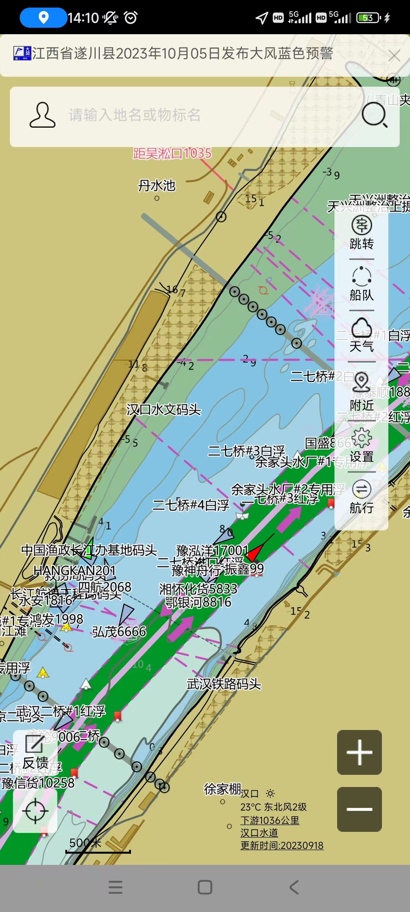
2. China IENC Produce Status
Publish to the public: 6500km，high-grade waterways
Mainly include the Yangtze River and it’s branches and Beijing-Hangzhou Grand Canal.
www. cjhy.com.cn
Notes:
About 6500km IENC can be published to the public, which mainly include
You can browse these maps on this website: www. cjhy.com.cn

Slide 9
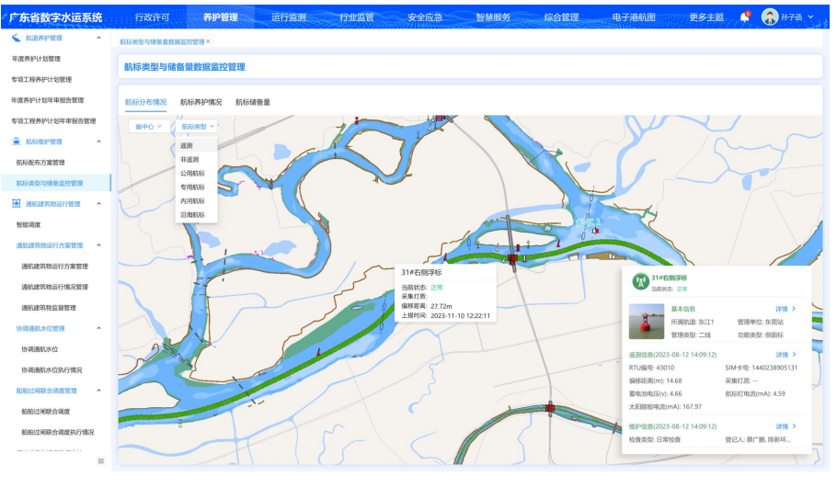
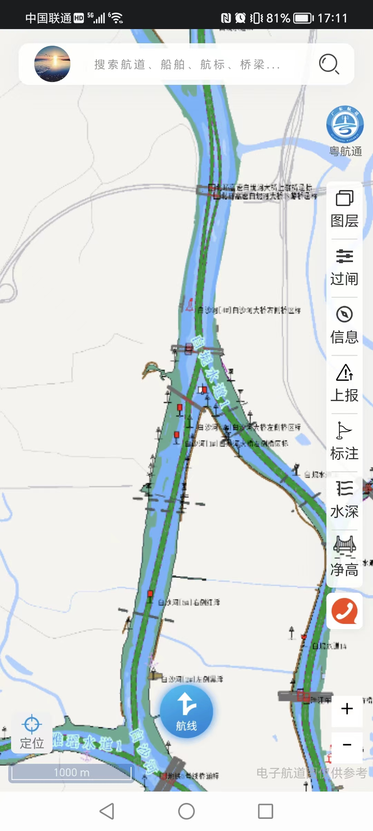
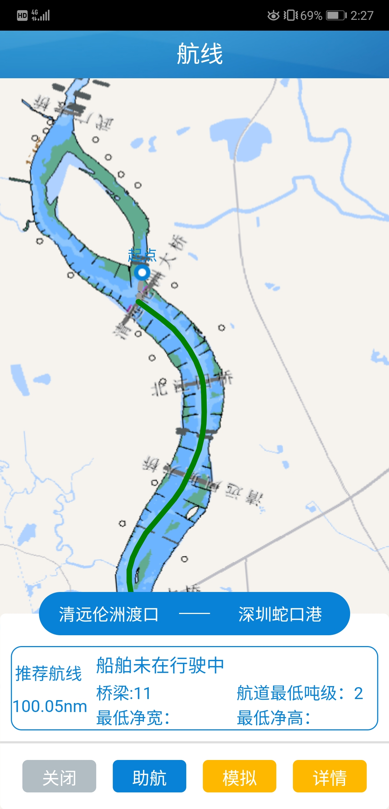
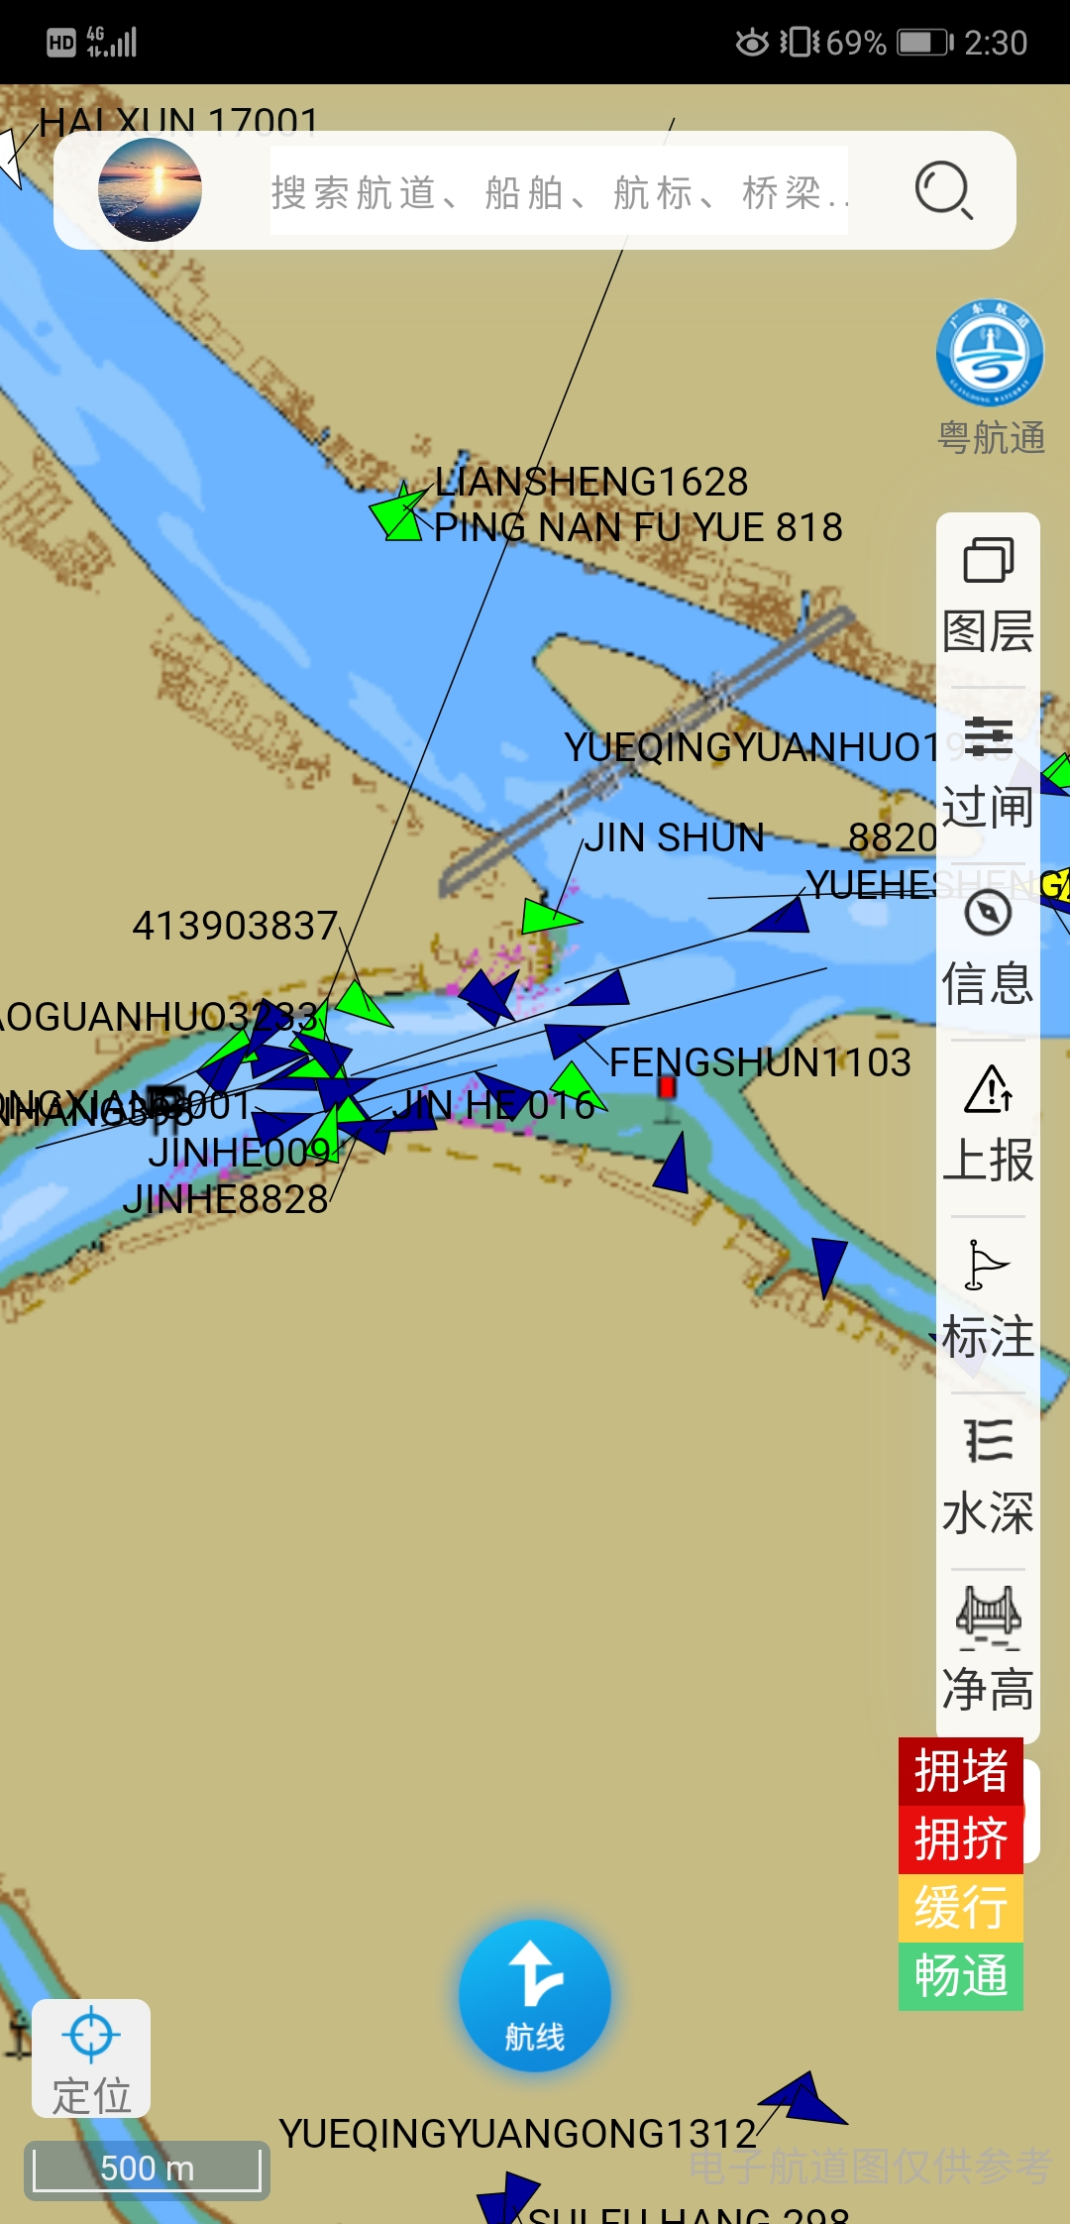
2. China IENC Produce Status
Publish only for inner waterway managers: 9400km，high grade waterway
Notes:
In China most IENC belong to secret data, that cannot be released to the public without official review.
so they can only be available for inner waterway managers.
Now, about 9400km IENCs are using by inner managers.

Slide 10
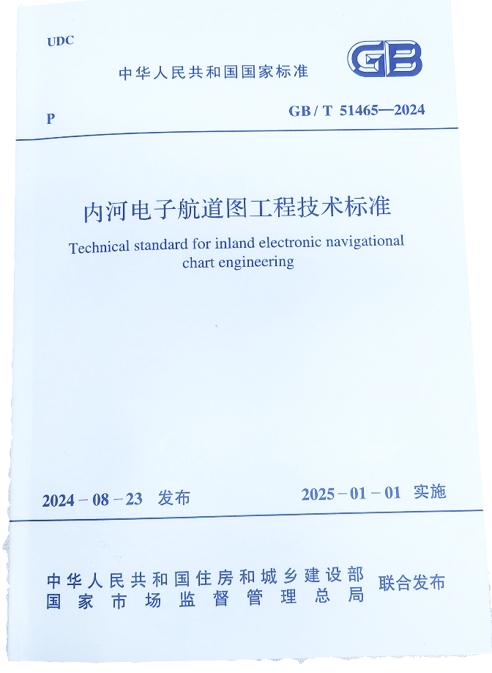
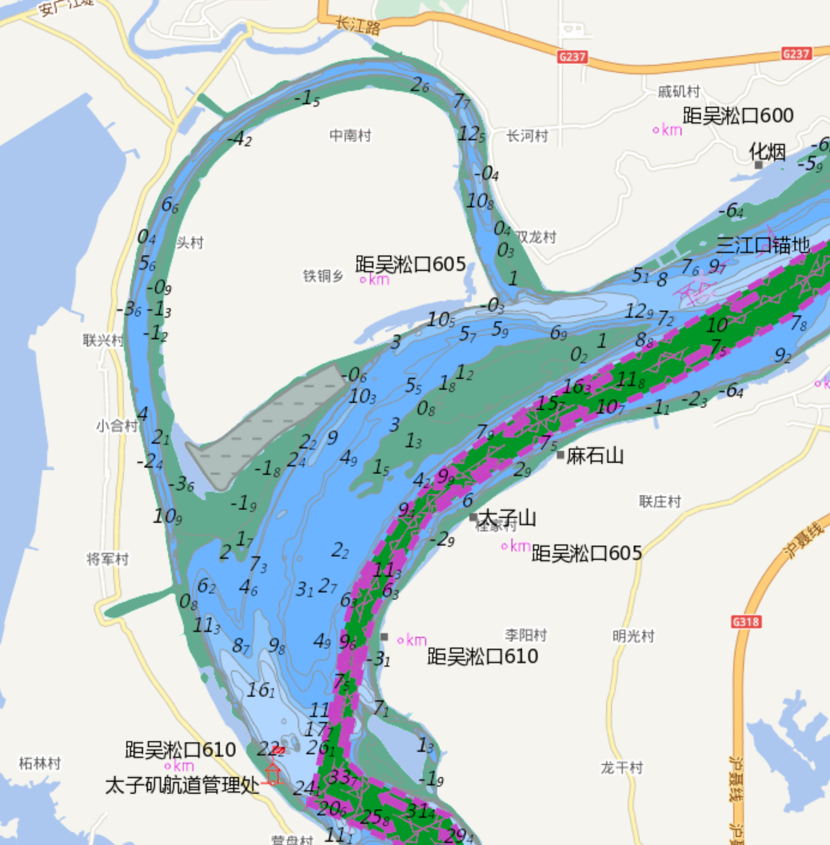
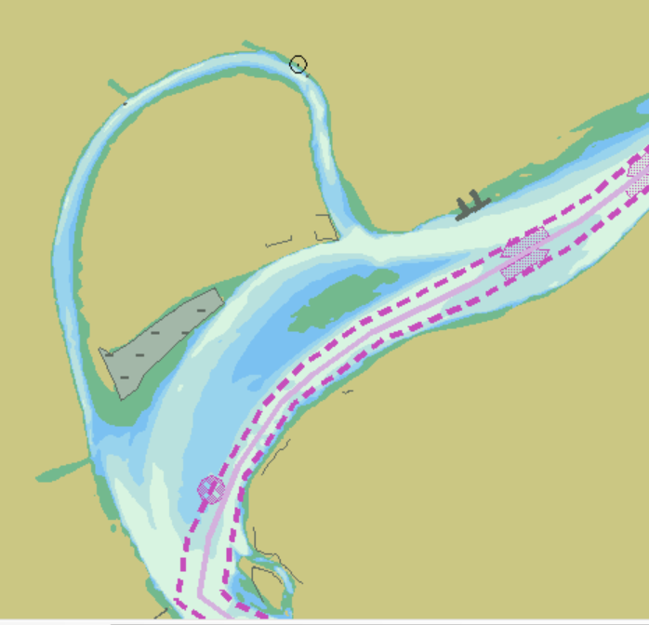
3. China IENC Standards Used
China IENC standards mainly include two types
National Standard: Technical standard for IENC engineering
*.000 file
GIS standards-OGC Map Service standards
Notes:
Everyone knows that the ienc data format is
We publish GIS map data according to the OGC map service standards

Slide 11
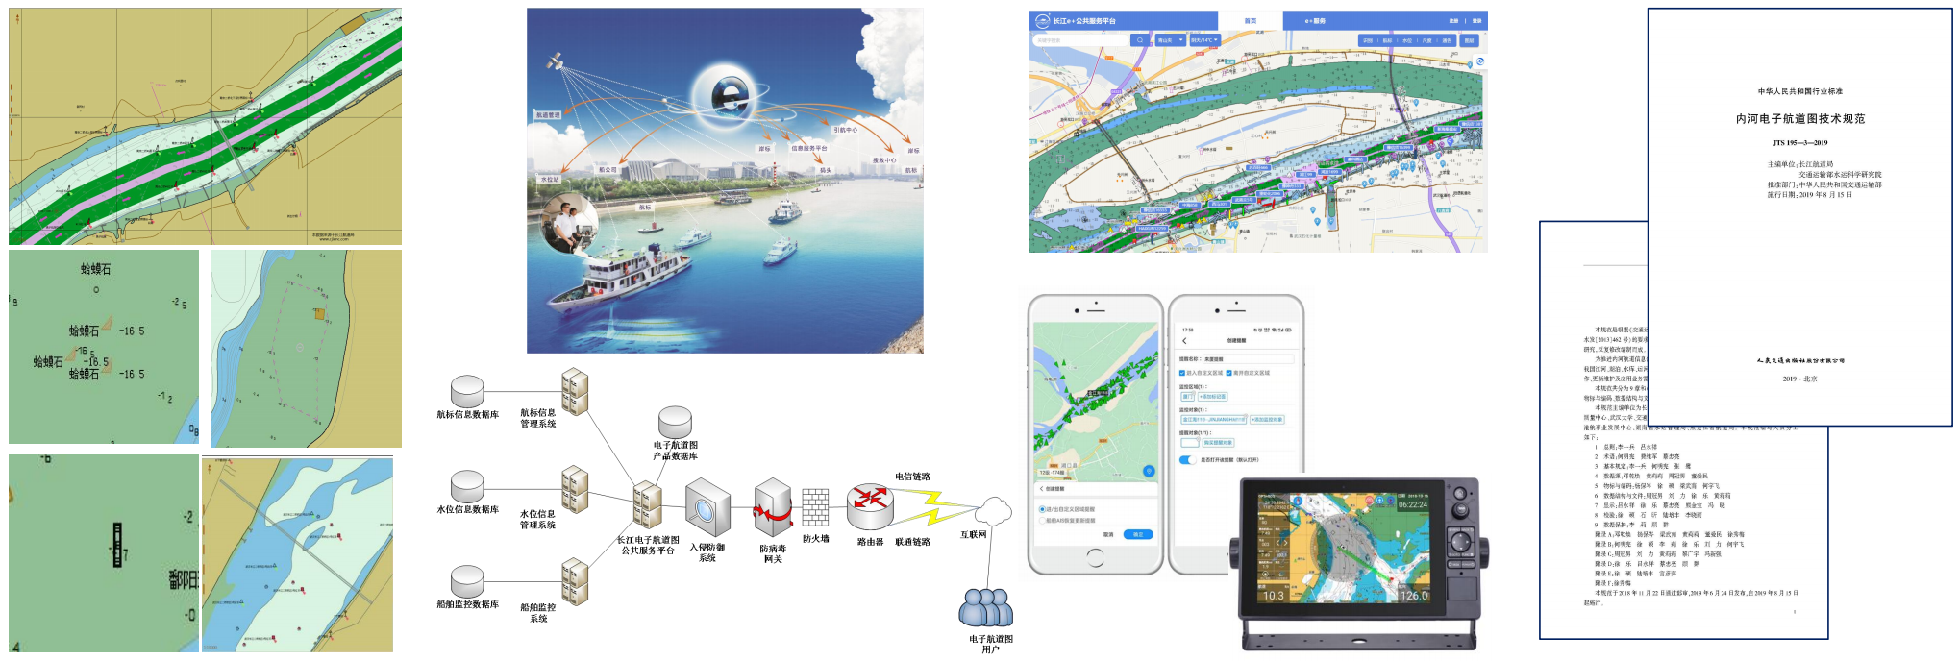
3. China IENC Standards Used
China IENC standards mainly include two types
GIS maps of Inland waterway are widely used on shore or on board
IENCs are mainly used on board.
Notes:
We publish GIS map data according to the OGC map service standards

Slide 12
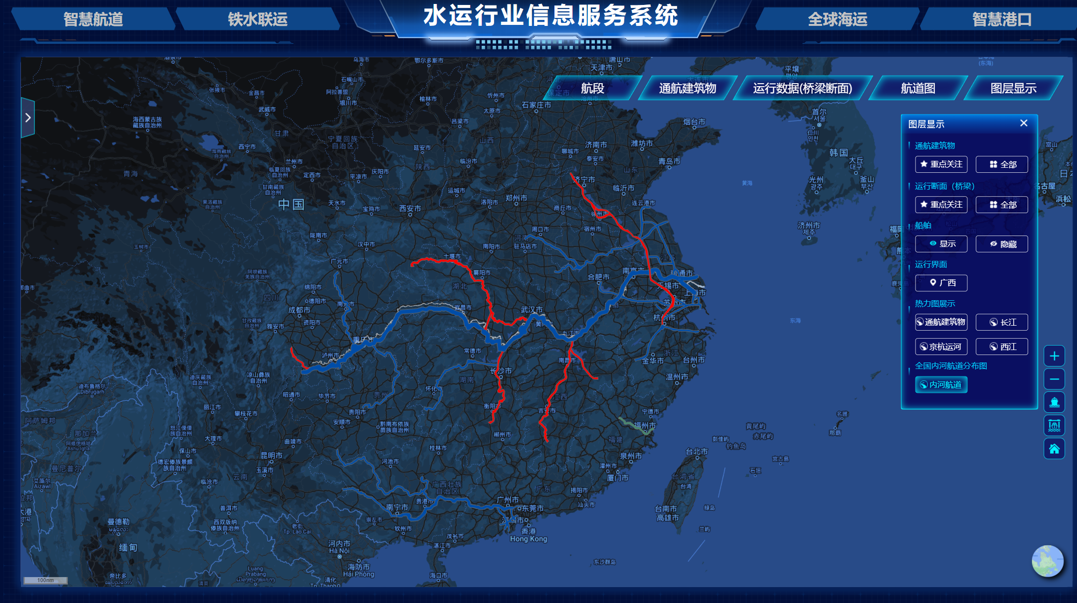
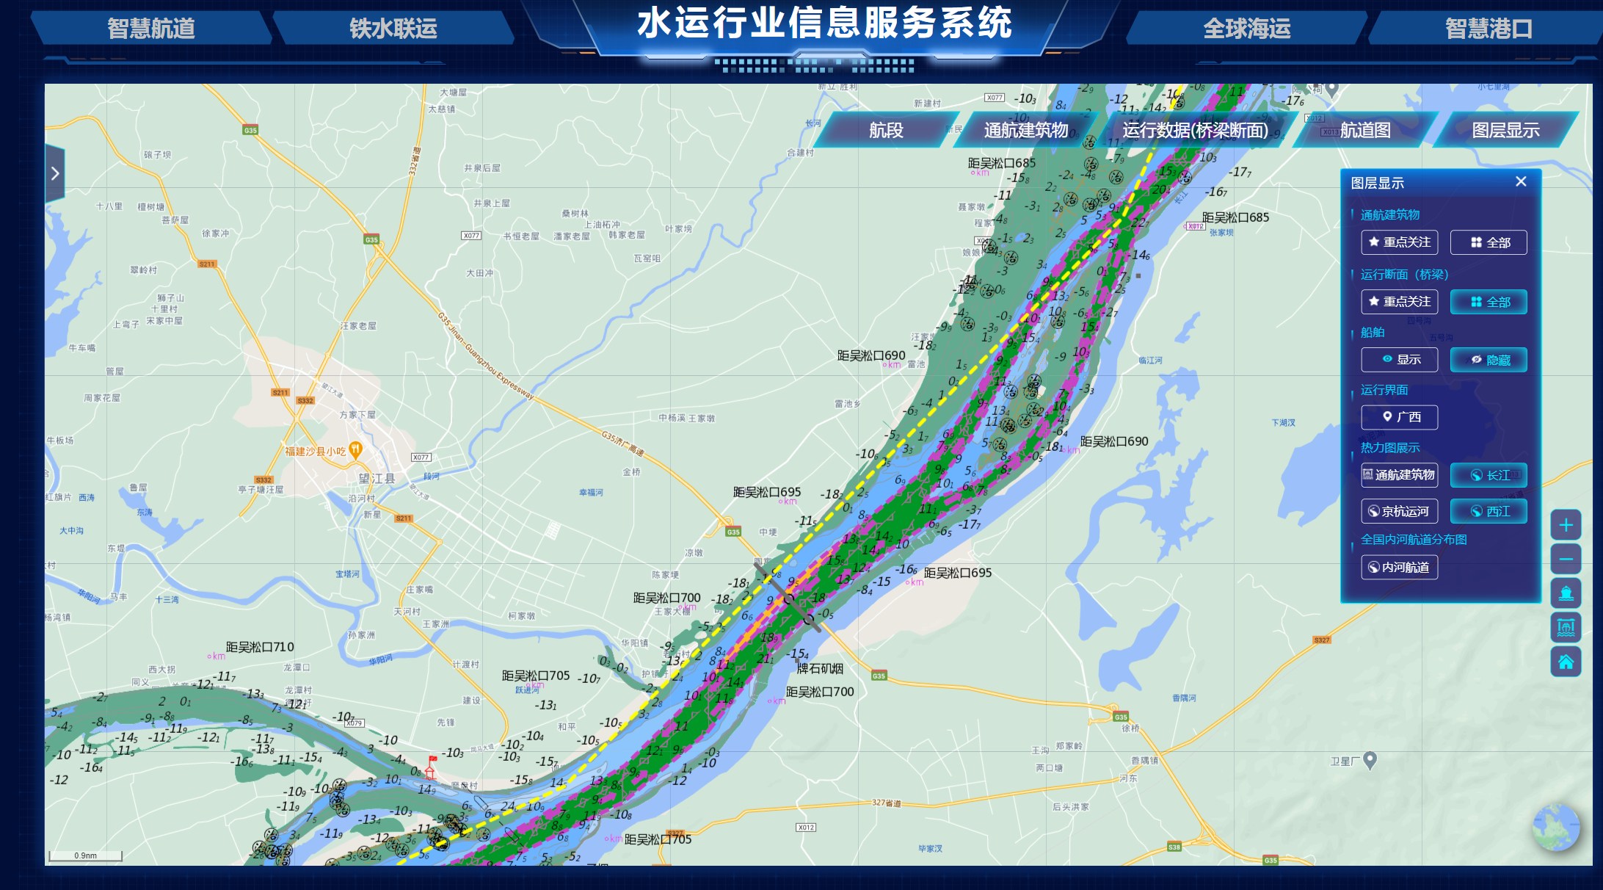
4. National Inland Waterway Map of China
I am producing the national inland waterway map of China based on the IENC national standard and the GIS standards, according to the requirements of the Ministry of Transport of the PRC.

Slide 13
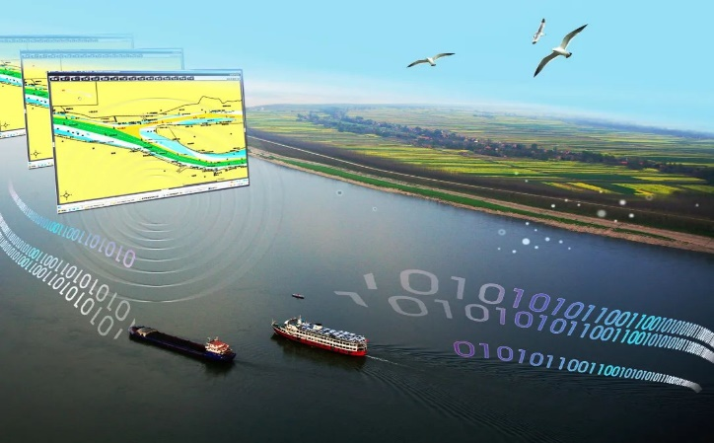
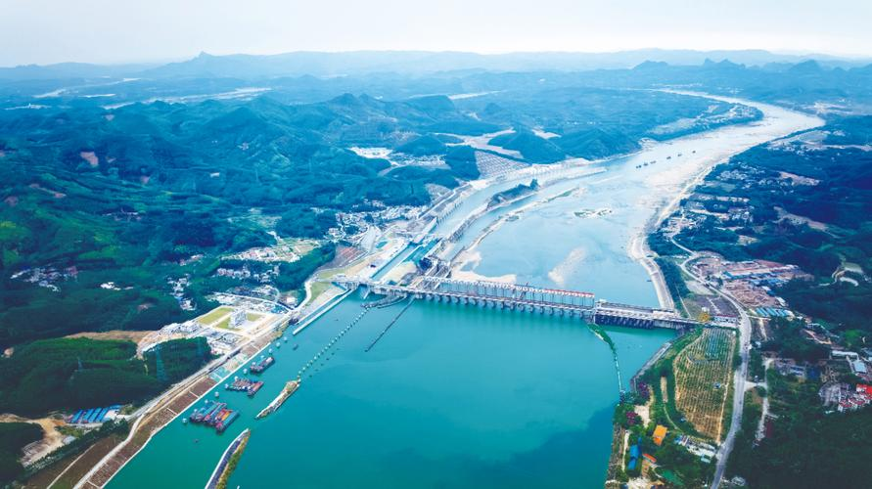
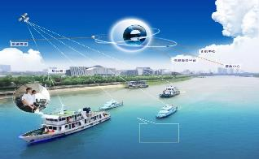
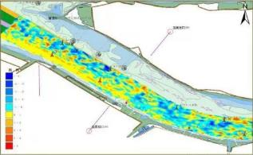
Thank you！

